Slide 1

UNIT - VI File Organization and Trends in Databases

Slide 2
Introduction
A database consist of a huge amount of data. The data is grouped within a table in RDBMS, and each table have related records.
A user can see that the data is stored in form of tables, but in actual this huge amount of data is stored in physical memory in form of files.
FILE – A file is named collection of related information that is recorded on secondary storage such as magnetic disks, magnetic tables and optical disks.

Slide 3
What is File Organization?
File Organization refers to the logical relationships among various records that constitute the file, particularly with respect to the means of identification and access to any specific record.
In simple terms, “Storing the files in certain order” is called FILE ORGANIZATION.
File Structure refers to the format of the label and data blocks and of any logical control record.

Slide 4
Types of File Organizations
It is all upon the programmer to decide the best suited file Organization method according to his requirements.
Some types of File Organizations are :
Sequential File Organization
Heap File Organization
Hash File Organization
B+ Tree File Organization
Clustered File Organization

Slide 5
Sequential File Organization
An easiest method for file Organization.
In this method, the file are stored one after another in a sequential manner.
There are 2 ways to implement this method:
Pile File Method
Sorted File Method

Slide 6
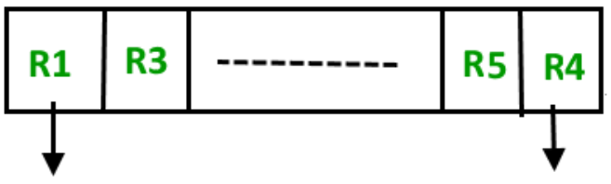
Pile File Method:
Quite simple, in which we store the records in a sequence.
It means, one after other in the order in which they are inserted into the tables.
Insertion of new record
Let the R1, R3 and so on up to R5 and R4 be four records in the sequence.
Here, records are nothing but a row in any table.
Suppose a new record R2 has to be inserted in the sequence, then it is simply placed at the end of the file.
Start of the file
End of the file

Slide 7
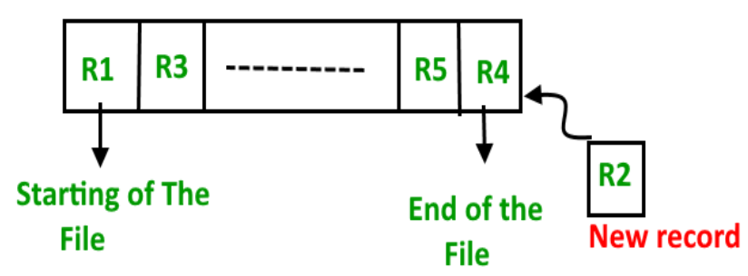
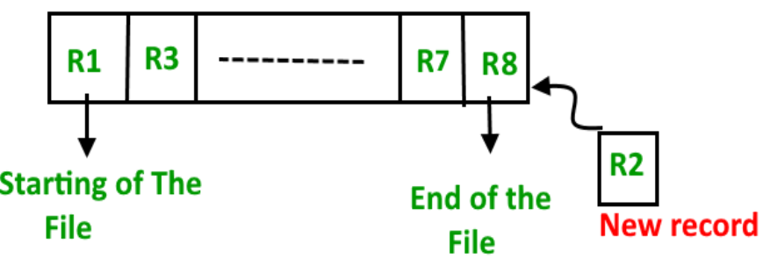
Sorted File Method
As the name itself suggest whenever a new record has to be inserted, it is always inserted in a sorted (ascending or descending) manner.
Sorting of records may be based on any primary key or any other key.

Slide 8
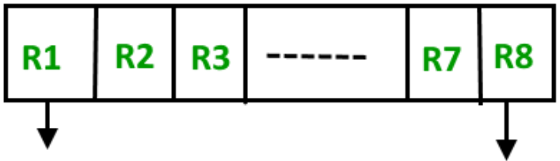
Insertion of new record
Let us assume that there is a preexisting sorted sequence of four records R1, R3, and so on up to R7 and R8.
Suppose a new record R2 has to be inserted in the sequence, then it will be inserted at the end of the file and then it will sort the sequence.
Start of the file
End of the file

Slide 9
Pros and Cons of Sequential File Organization
Pros –
Fast and efficient method for huge amount of data.
Simple design.
Files can be easily stored in magnetic tapes, i.e. cheaper storage mechanism.
Cons –
Time wastage as we cannot jump on a particular record that is required, but we have to move in a sequential manner which takes our time.
Sorted file method is inefficient as it takes time and space for sorting records.

Slide 10
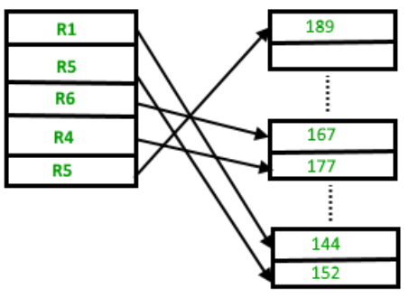
Heap File Organization
It works with data blocks.
In this method, records are inserted at the end of the file, into the data blocks.
No Sorting or Ordering is required in this method.
If a data block is full, the new record is stored in some other block, here the other data block need not be the very next data block, but it can be any block in the memory.
It is the responsibility of DBMS to store and manage the new records.

Slide 11
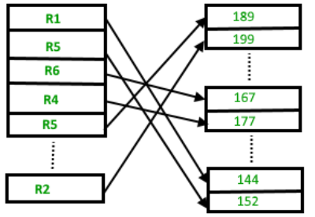
Insertion of new record:
Suppose we have four records in the heap R1, R5, R6, R4 and R3.
Suppose a new record R2 has to be inserted in the heap then, since the last data block i.e. data block 3 is full it will be inserted in any of the data blocks selected by the DBMS, lets say data block 1.
If we want to search, delete or update data in heap file Organization the we will traverse the data from the beginning of the file till we get the requested record. Thus if the database is very huge, searching, deleting or updating the record will take a lot of time.

Slide 12
Pros and Cons of Heap File Organization
Pros –
Fetching and retrieving records is faster than sequential record but only in case of small databases.
When there is a huge number of data needs to be loaded into the database at a time, then this method of file Organization is best suited.
Cons –
Problem of unused memory blocks.
Inefficient for larger databases.

Slide 13
B+ Tree File Organization
As the name suggests, it uses a tree like structure to store records in File.
It uses the concept of Key indexing where the primary key is used to sort the records.
For each primary key, an index value is generated and mapped with the record. An index of a record is the address of record in the file.
Its is similar to binary search tree, with the only difference that instead of just two children, it can have more than two.
All the information is stored in leaf node and the intermediate nodes acts as pointer to the leaf nodes.
The information in leaf nodes always remain a sorted sequential linked list.

Slide 14
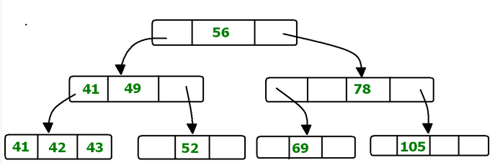
56 is the root node which is also called the MAIN NODE OF THE TREE.
The intermediate nodes here, just consist the address of leaf nodes. They do not contain any actual record.
Leaf nodes consist of the actual record.
All leaf nodes are balanced.

Slide 15
Pros and Cons of B+ Tree File Organization
Pros
Tree traversal is easier and faster.
Searching becomes easy as all records are stored only in leaf nodes and are sorted sequential linked list.
There is no restriction on B+ tree size. It may grows/shrink as the size of data increases/decreases.
Cons
Inefficient for static tables.

Slide 16
Cluster File Organization
2 or more related tables/records are stored within the same file known as CLUSTERS.
These files will have 2 or more tables in the same data block and the key attributes which are used to map these table together are stored only once.
Thus, it lowers the cost of searching and retrieving various records in different files as they are now combined and kept in a single cluster.
For example, we have two tables or relation Employee and Department. These table are related to each other.

Slide 17
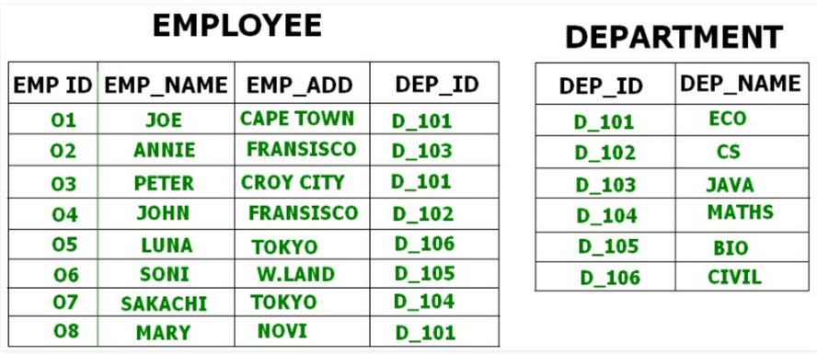
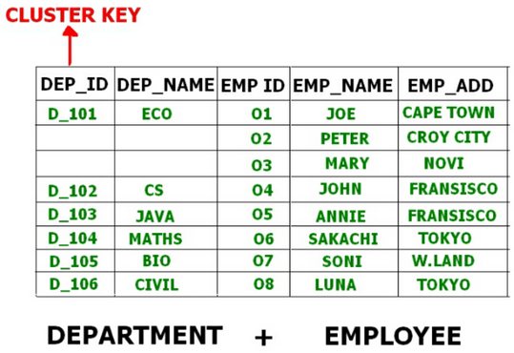
Therefore, these tables are allowed to combine using a join operation and can be seen in a cluster file.

Slide 18
Types of Cluster File Organization
There are 2 ways to implement this method:
INDEXED CLUSTERS :
In Indexed clustering, the records are group based on the cluster key and stored together.
The above mentioned example of the Employee and Department relationship is an example of Indexed Cluster where the records are based on the Department ID.
HASH CLUSTERS:
This is very much similar to indexed cluster with only difference that instead of storing the records based on cluster key.
We generate hash key value and store the records with same hash key value.

Slide 19
Hashing And Its Techniques

Slide 20
Hash File Organization
When we want to retrieve a particular data, it becomes very inefficient to search all the index values and reach the desired data.
In this situation, Hashing technique comes into picture.
Hashing is an efficient technique to directly search the location of desired data on the disk without using index structure.
Data is stored at the data blocks whose address is generated by using hash function.
The memory location where these records are stored is called as DATA BLOCK or DATA BUCKET.

Slide 21
Hash File Organization
Data bucket: It is the memory locations where the records are stored. These buckets are also considered as Unit Of Storage.
Hash Function: It is a mapping function that maps all the set of search keys to actual record address. Generally, hash function uses primary key to generate the hash index – address of the data block. Hash function can be simple mathematical function to any complex mathematical function.
Hash Index: The prefix of an entire hash value is taken as a hash index. Every hash index has a depth value to signify how many bits are used for computing a hash function. These bits can address 2n buckets. When all these bits are consumed ? Then the depth value is increased linearly and twice the buckets are allocated.

Slide 22
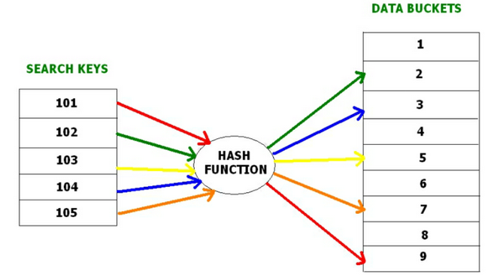
Hash File Organization

Slide 23
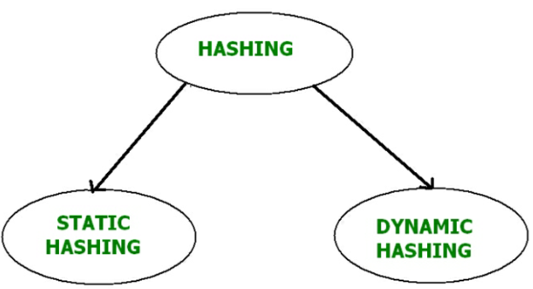
Types of Hashing

Slide 24
Static Hashing
When a search-key value is provided, the hash function always computes the same address.
For example, if we want to generate address for STUDENT_ID = 104 using mod (5) hash function, it always result in the same bucket address 4.
Operations –
Insertion: When a new record is inserted into the table, The hash function h generate a bucket address for the new record based on its hash key K.
Bucket address = h(K)
Deletion: We will first fetch the record which is supposed to be deleted, then we will remove the records for that address in memory.

Slide 25
Searching:
When a record needs to be searched, the same hash function is used to retrieve the bucket address for the record.
For Example, if we want to retrieve whole record for ID 104, and if the hash function is mod(5) on that ID, the bucket address generated would be 4.
Then, we will directly got to address 4 and retrieve the whole record for ID 104. Here ID acts as a hash key.
Updation: The data record that needs to be updated is first searched using hash function, and then the data record is updated.
Now, if we want to insert some new records into the file, but the data bucket address generated by the hash function is not empty or the data already exists in that address.
This becomes a critical situation to handle. This situation in the static hashing is called bucket overflow. How will we insert data in this case?

Slide 26
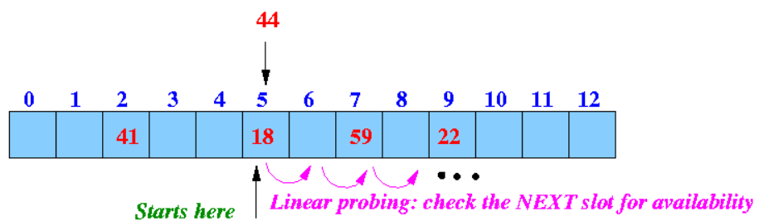
There are several methods provided to overcome “Bucket Overflow”. Some commonly used methods are discussed below:
Open Hashing
Next available data block is used to enter the new record, instead of overwriting older one. This method is also called LINEAR PROBING.
For example:
Input keys: 8, 41, 22, 44, 59, 32, 31, 73
Hash function: h(k) = k % 13

Slide 27
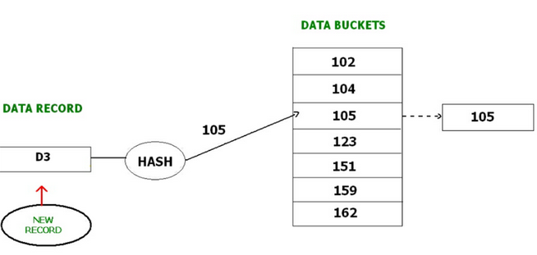
Closed Hashing
In Closed hashing method, a new data bucket is allocated with same address and is linked it after the full data bucket.
This method is also known as OVERFLOW CHAINING.
For example, we have to insert a new record D3 into the tables. The static hash function generates the data bucket address as 105. But this bucket is full to store the new data. In this case is a new data bucket is added at the end of 105 data bucket and is linked to it. Then new record D3 is inserted into the new bucket.

Slide 28
Quadratic probing :
Quadratic probing is very much similar to open hashing or linear probing. Here, the only difference between old and new bucket is linear. Quadratic function is used to determine the new bucket address.
Double Hashing :
Double Hashing is another method similar to linear probing. Here the difference is fixed as in linear probing, but this fixed difference is calculated by using another hash function. That’s why the name is double hashing.

Slide 29
Dynamic Hashing
The drawback of static hashing is that that it doesn’t expand or shrink dynamically as the size of the database grows or shrinks.
In Dynamic hashing, data buckets grows or shrinks (added or removed dynamically) as the records increases or decreases.
Dynamic hashing is also known as EXTENDED HASHING.
In dynamic hashing, the hash function is made to produce a large number of values.

Slide 30
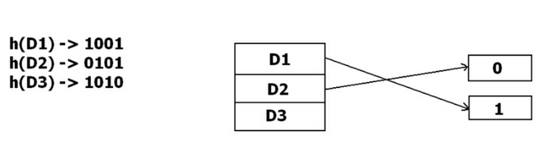
Example:
There are three data records D1, D2 and D3.
The hash function generates three addresses 1001, 0101 and 1010 respectively.
This method of storing considers only part of this address – especially only first one bit to store the data.
So it tries to load three of them at address 0 and 1.

Slide 31
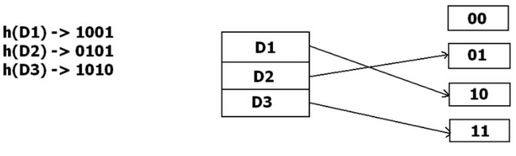
But the problem is that No bucket address is remaining for D3.
The bucket has to grow dynamically to accommodate D3.
So it changes the address have 2 bits rather than 1 bit, and then it updates the existing data to have 2 bit address.
Then it tries to accommodate D3.

Slide 32
Indexing And Its Techniques

Slide 33
Introduction
INDEXING is a way to optimize the performance of a database by minimizing the number of disk accesses required when a query is processed.
It is a data structure technique which is used to quickly locate and access the data in a database.
Indexes are created using a few database columns.

Slide 34
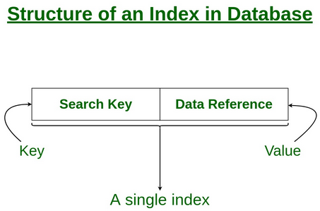
The first column is the SEARCH KEY that contains a copy of the primary key or candidate key of the table. These values are stored in sorted order so that the corresponding data can be accessed quickly. Note: The data may or may not be stored in sorted order.
The second column is the DATA REFERENCE or POINTER which contains a set of pointers holding the address of the disk block where that particular key value can be found.

Slide 35
Mechanisms followed by Indexing
There are 2 types of file organization mechanism which are followed by the indexing methods to store the data:
Sequential File Organization or Ordered Index File
Hash File organization

Slide 36
Sequential File Organization/Ordered Index File
The indices are based on a sorted ordering of the values.
These are generally fast and a more traditional type of storing mechanism.
These Ordered or Sequential file organization might store the data in a dense or sparse format.
Dense Index:
For every search key value in the data file, there is an index record.
This record contains the search key and also a reference to the first data record with that search key value.

Slide 37
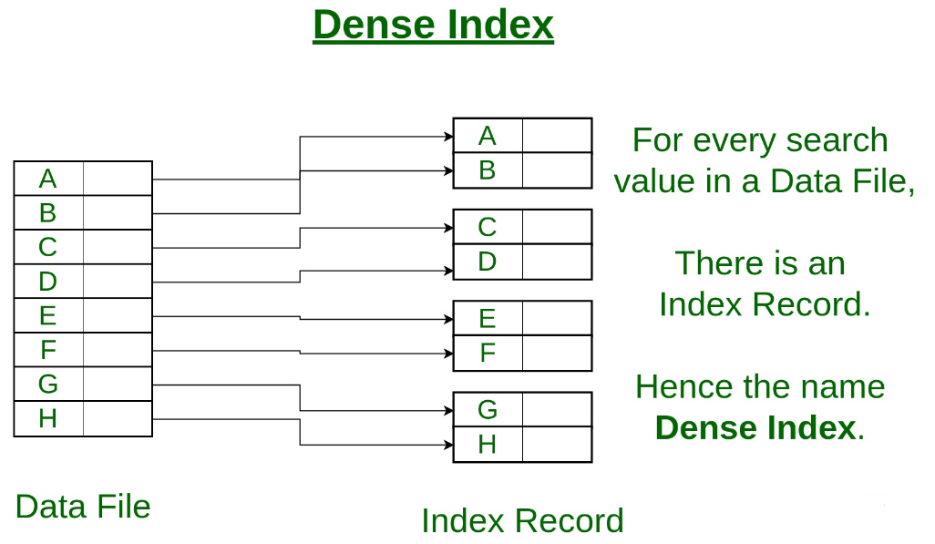

Slide 38
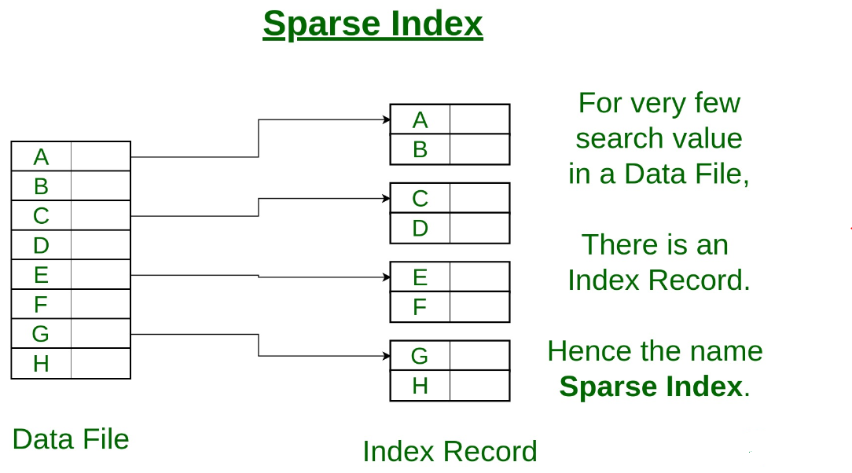
Sparse Index:
The index record appears only for a few items in the data file. Each item points to a block as shown.
To locate a record, we find the index record with the largest search key value less than or equal to the search key value we are looking for.
We start at that record pointed to by the index record, and proceed along with the pointers in the file (that is, sequentially) until we find the desired record.

Slide 39
Hash File Organization
Indices are based on the values being distributed uniformly across a range of buckets.
The buckets to which a value is assigned is determined by a function called a HASH FUNCTION.

Slide 40
Indexing Techniques
There are primarily 3 methods of indexing:
Clustered Indexing
Non-Clustered or Secondary Indexing
Multilevel Indexing

Slide 41
Clustered Indexing :
Clustering index is defined on an ordered data file.
The data file is ordered on a non-key field. In some cases, the index is created on non-primary key columns which may not be unique for each record.
In such cases, in order to identify the records faster, we will group two or more columns together to get the unique values and create index out of them.
Basically, records with similar characteristics are grouped together and indexes are created for these groups.
For example, students studying in each semester are grouped together. i.e. 1st Semester students, 2nd semester students, 3rd semester students etc. are grouped.

Slide 42
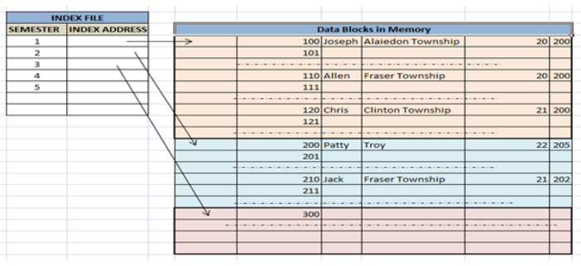
Primary Indexing:
This is a type of Clustered Indexing wherein the data is sorted according to the search key and the primary key of the database table is used to create the index.
It is a default format of indexing where it induces sequential file organization. As primary keys are unique and are stored in a sorted manner, the performance of the searching operation is quite efficient.

Slide 43
Non-clustered or Secondary Indexing
It gives us a list of virtual pointers or references to the location where the data is actually stored.
Data is not physically stored in the order of the index, rather data is present in leaf nodes.
For example: the contents page of a book. Each entry gives us the page number or location of the information stored. The actual data here(information on each page of the book) is not organized but we have an ordered reference(contents page) to where the data points actually lie.
It requires more time as compared to the clustered index because some amount of extra work is done in order to extract the data by further following the pointer.
In the case of a clustered index, data is directly present in front of the index.

Slide 44
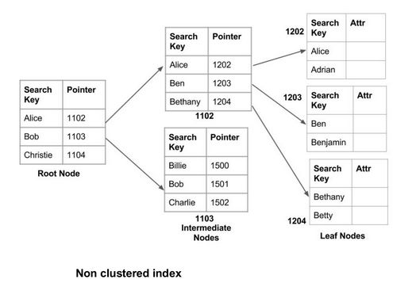

Slide 45
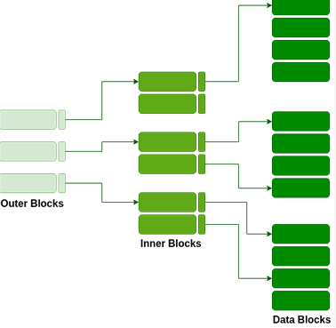
Multilevel Indexing:
As the index is stored in the main memory, a single-level index might become too large a size to store with multiple disk accesses.
The multilevel indexing segregates the main block into various smaller blocks so that the same can stored in a single block.
The outer blocks are divided into inner blocks which in turn are pointed to the data blocks.
This can be easily stored in the main memory with fewer overheads.

